Slide 1

Retrieving Snowpack Properties From Land Surface Microwave Emissivities Based on Artificial Neural Network Techniques
Narges Shahroudi
William Rossow
NOAA-CREST
City College of New York
CoRP 10th Annual Science Symposium
Tuesday, September 09, 2014

Slide 2
Introduction
Why Measure snow?
Snow cover is a significant climate indicator and an important factor controlling the amount of solar radiation absorbed by earth.
Snowmelt resulting from a warming trend increases the absorption of solar radiation, a positive feedback.
Melting snow is a major source of the water involved in a flood, it is considered a snowmelt flood.
Snow acts as a temporary reservoir of water that is crucial to water supply in many areas.
Snow plays a different role than liquid water in the processes affecting surface evaporation(latent heat), soil moisture supply to vegetation and runoff.
SWE is fundamental for hydrological, meteorological, and climatological applications as well as for discharge forecasting for hydropower production.

Slide 3
Project Research Objectives
The objective of this work is to advance the use of satellite measurements for characterizing the spatial and temporal variations of snowcover in the Northern Hemisphere and improved physical retrievals of snowpack properties:
Isolate the snow signature from the microwave signal.
Use satellite microwave measurements to retrieve properties of snowpack based on neural network techniques.

Slide 4
Passive Microwave and snowpack
Penetration through non-precipitating clouds and at night
Provide information on the internal properties of the snowpack
Lower resolution compared to VIS/IR sensors
The microwave signal acquired from the satellite is the combination of the
land surface and atmospheric contributions.
The microwave emission of the land surface itself is the product of its
physical temperature and the surface emissivity (this product is the
brightness temperature).
The surface emissivity represents the intrinsic physical characteristics of the land surface and depends on surface composition (soil, vegetation, snow, wetness).

Slide 5
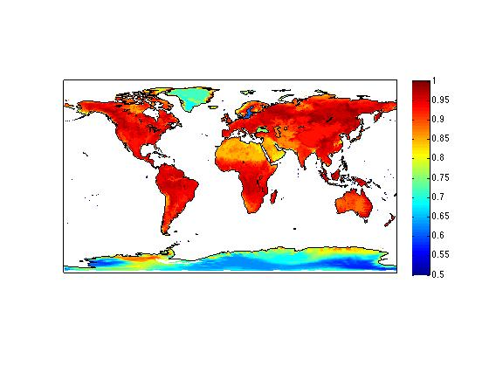
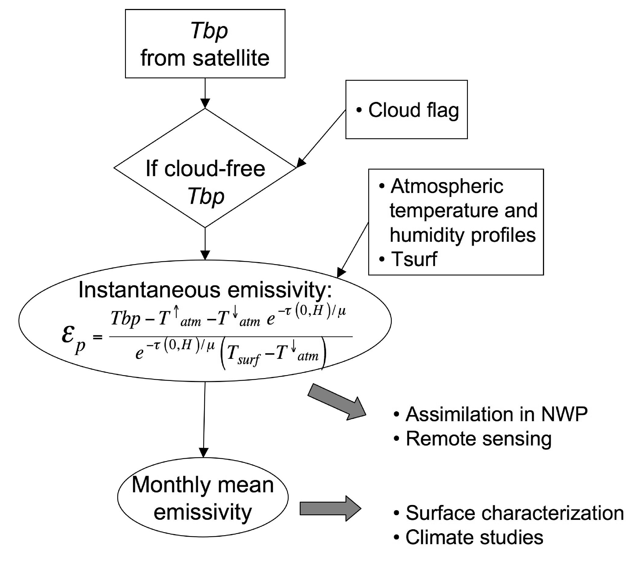
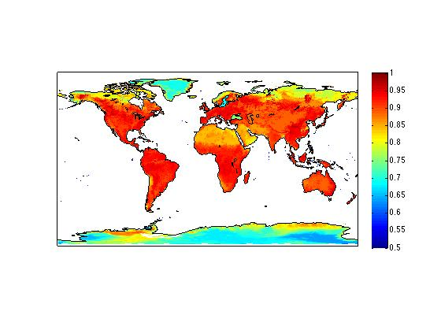
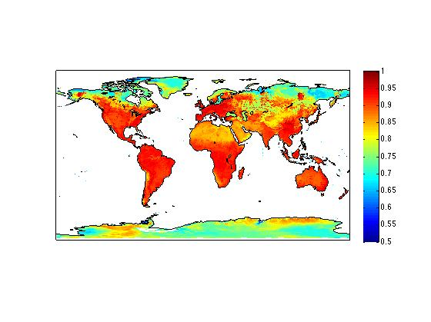
Microwave emissivities of land surfaces
Tb_{p} - Tup - Tdown . τ
τ . (Ts - Tdown)
Tb_{p} = ε_{p}.Ts.τ + (1-ε_{p}).Tdown.τ + Tup
ε_{p}=
The SSM/I sensor the Defense Meteorological Satellite Program (DMSP) polar orbiters
observe the Earth twice daily (typically near dawn and dusk)
Incident angle close to 53° for flat a surface
field-of-view decreasing with frequency from 43 km x 69 km at 19 GHz to 13 km x 15 km at 85 GHz.
The SSM/I channels measure brightness temperatures (TB) at 19.3 GHz, 22.2 GHz, 37.0 GHz and 85.5 GHz at vertical and horizontal polarizations except at 22 GHz,which is only in vertical.
Emissivity 19H, 37H, 85H
Ts is the IR surface skin temperature Retrieval of an ‘effective’ emissivity
For the SSM/I processing:
  ISCCP cloud flag and Tsurf
  NCEP reanalysis
  (Prigent et al., JGR, 1997; BAMS, 2006)
The methodoloy used for other instruments: AMSU (Karbou et al., 2005, Prigent et al., 2005), AMSR-E (Moncet et al. , 2008)

Slide 6
Snow Signature Isolation
δEM19-37=EM19-37-[EM19-37]
δEM19-85=EM19-85-[EM19-85]
where [] indicates the average over the summer season at the same location
Anomaly Emissivity difference
Notes:
The (approximately) 10% overlap of the snow-covered and snow-free distributions of effective emissivity difference has been reduced by about a factor of 3-4 for the anomaly emissivity difference. The reduction is largest for EM19-85 as expected. By subtracting the mean summer effective emissivity difference from the daily effective emissivity differences in winter, we are taking out a constant offset approximately representing the effect on the microwave signal from the underlying land surface.

Slide 7
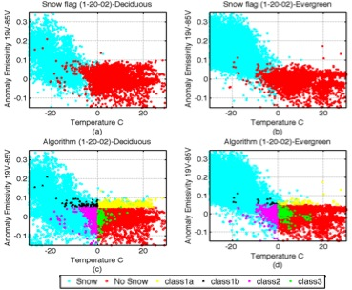
Snow signature Isolation
Vegetation | NOAA Snow Cover Charts | δEM19-85> 0.05 | δEM19-85<0.05 TS<0 | δEM19-85<0.05 TS>0
Evergreen | Snow | 78.35% | 9.08% | 0.81%
 | No Snow | 0.82% | 0.66% | 10.29%
Deciduous | Snow | 53.79% | 17.37% | 0.31%
 | No Snow | 2.15% | 8.04% | 18.33%
Vegetation | NOAA Snow Cover Charts | δEM19-85> 0.05 | δEM19-85<0.05 TS<0 | δEM19-85<0.05 TS>0
Evergreen | Snow | 78.35% | 9.08% | 0.81%
 | No Snow | 0.82% | 0.66% | 10.29%
Deciduous | Snow | 53.79% | 17.37% | 0.31%
 | No Snow | 2.15% | 8.04% | 18.33%

Slide 8
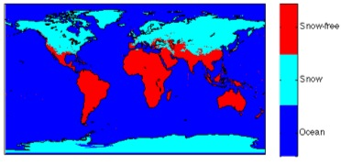
Snow signature Isolation
If δEM19-85 ≥ 0.05 => Snow
If δEM19-85 < 0.05 & TS <0 => Snow
If δEM19-85 < 0.05 & TS ≥0 => Snow-free
NOAA Snow Cover Charts | δEM19-85> 0.05 | δEM19-85<0.05 TS<0 | δEM19-85<0.05 TS>0
Snow | 61.99% | 17.27% | 1.67%
No Snow | 1.07% | 3.04% | 14.95%
Agree:94%
Disagree:6%

Slide 9
Snowpack retrieval
Objective of this section is to retrieve snow properties from observed passive microwave data.
One way to retrieve snow parameters from remote sensing passive microwave is by employing electromagnetic models to the data. .
MEMLS is a forward model, which takes the snow properties as its inputs and calculates the emission and total attenuation properties of snow layers based on a radiate transfer approach.
Design a method which inverse the model in a way that it takes the passive microwave as its inputs and retrieve the snow properties as its outputs. (neural network)

Slide 10
Model Input
Depth
Density
Surface Temp
Grain size
Water%
Ground emissivity
Model Output
Emissivity (7 Frequencies)
MEMLS
Model Simulation
N.N Output
Depth
Density
Grain size
Water%
N.N Input
Emissivity (7 Frequencies
Surface Temp
Ground emissivity
A.N.N
Neural
Network
Training
N.N Output
Depth
Density
Grain size
Water%
N.N Input
Observed Emissivity (7 Frequencies
Surface Temp
Ground emissivity
A.N.N
Neural Network Retrieval

Slide 11
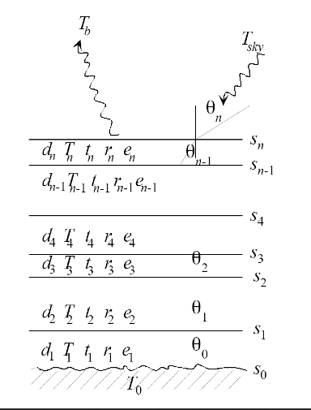
MEMLS
Microwave Emission of Layerd snowpacks (MEMLS) to simulate microwave radiation of snow-covered land (Wiesmann & Matzler 1999).
The input parameters of MEMLS are derived from vertical profiles of the snowpack:
  Depth
  Temperature
  Density
  Grain size
  Liquid water Content
MEMLS documentation, Matzler , 2007

Slide 12
Model Simulation
Sensitivity of each of the snow parameters using the model:
 | Depth (5-250) cm | Density (100-500)(Kg/m³) | Grain Size (.5-1.9) mm | Temp (240-300) K | Water Fraction (0-50%)
19V | 0.15 | 0.004 | 2.14 | 0.06 | 0.09
19H | 0.13 | 0.004 | 2.07 | 0.05 | 0.18
37V | 0.20 | 0.018 | 1.83 | 0.34 | 0.25
37H | 0.19 | 0.018 | 1.81 | 0.32 | 0.28
85V | 0.41 | 0.058 | 1.82 | 1.50 | 0.42

Slide 13
Neural Network Training
N.N Input
Emissivity (7 Frequencies
Surface Temp
Ground emissivity
N.N Output
Depth
Density
Grain Size
Water%
N.N
Input layer
Hidden layer
Output layer

Slide 14
Neural Network Retrieval
N.N Input
Observed Emissivity (7 Freq)
Surface Temp
Ground emissivity
N.N Output
Depth
Density
Grain Size
Water%
N.N

Slide 15
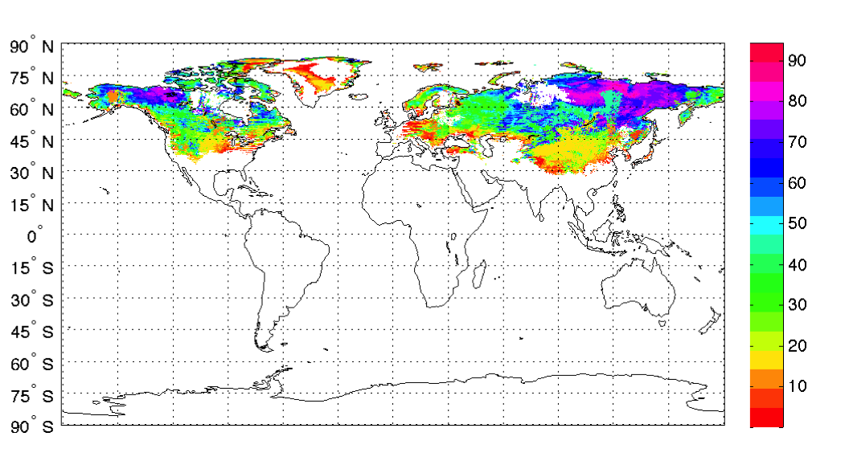
Neural Network Retrieval Results
Retrieved Snow Depth Map Dec 2003

Slide 16
Neural Network Retrieval Results
Comparison with CMC Snow Depth and Chang Algorithm:
Chang Algorithm => Snow Depth = 1.59*(TB19H-TB37H)

Slide 17
Neural Network Retrieval
N.N Input
Observed Emissivity (7 Freq)
Surface Temp
Ground emissivity
N.N Output
Depth
Density
Grain Size
Water%
Neural
Network Retrieval
N.N
Compare
Emissivities
Model input
Depth
Density
Grain Size
Water%
Surface Temp
Ground emissivity
Model Simulation
Model Output
Emissivity (7 Freq)
MEMLS

Slide 18
Neural Network Retrieval Results
85V for Depth<20
 | 19V | 85V
Mean | 0.001 | -0.007
Std | 0.02 | 0.06
fraction | 10% | 15%

Slide 19
Summary and Future Work
Snow emissivities were isolated from the microwave signal by employing a difference of effective emissivities at low and high frequency and determining the time-anomaly of this difference for each location, the constant effects of land surface vegetation properties was removed.
Snow depth, snow density, snow grain size, and water content were retrieved
based on a neural network technique and using the snow microwave emissivities.
The resulting depth were compared with other snow depth products
Future work
Evaluation of the results (getting SWE(snow water equivalent)= Depth x Density)
Study the Snow Wetness

Slide 20
Thank You
This work was supported by the National Oceanic and Atmospheric Administration – Cooperative Remote Sensing Science and Technology
Center (NOAA-CREST)

